Slide 1
HackZon 2022
Team Virus
Team Members :
Vinayak S Bangarshetra
Viswanath Kolli
Vamshi Krishna

Slide 2
Project objective: To find a one destination solution for all banking queries and informations

Slide 3
Solution or Idea
To provide people with all the informations required for efficient banking.The aim of our team is to devolop a website where people can find all the information of popular banks across india, like fixed deposit interest rates so that they can find the suitable banks for deposition, and evenloan interest details to help them out , where they can apply for loan and even they can compare between banks.
We used html to devolop the above mentioned website.

Slide 4
Implementation of Idea into the Project
The project provides with all the interest rates that help them in choosing the best bank.
For this we used html,which is the best way to create the desired website ,ofcourse we can find the interest rates in the respective bank websites but cannot compare between banks ,so this website serves the purpose.

Slide 5
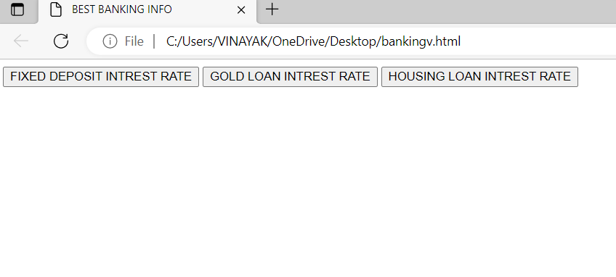
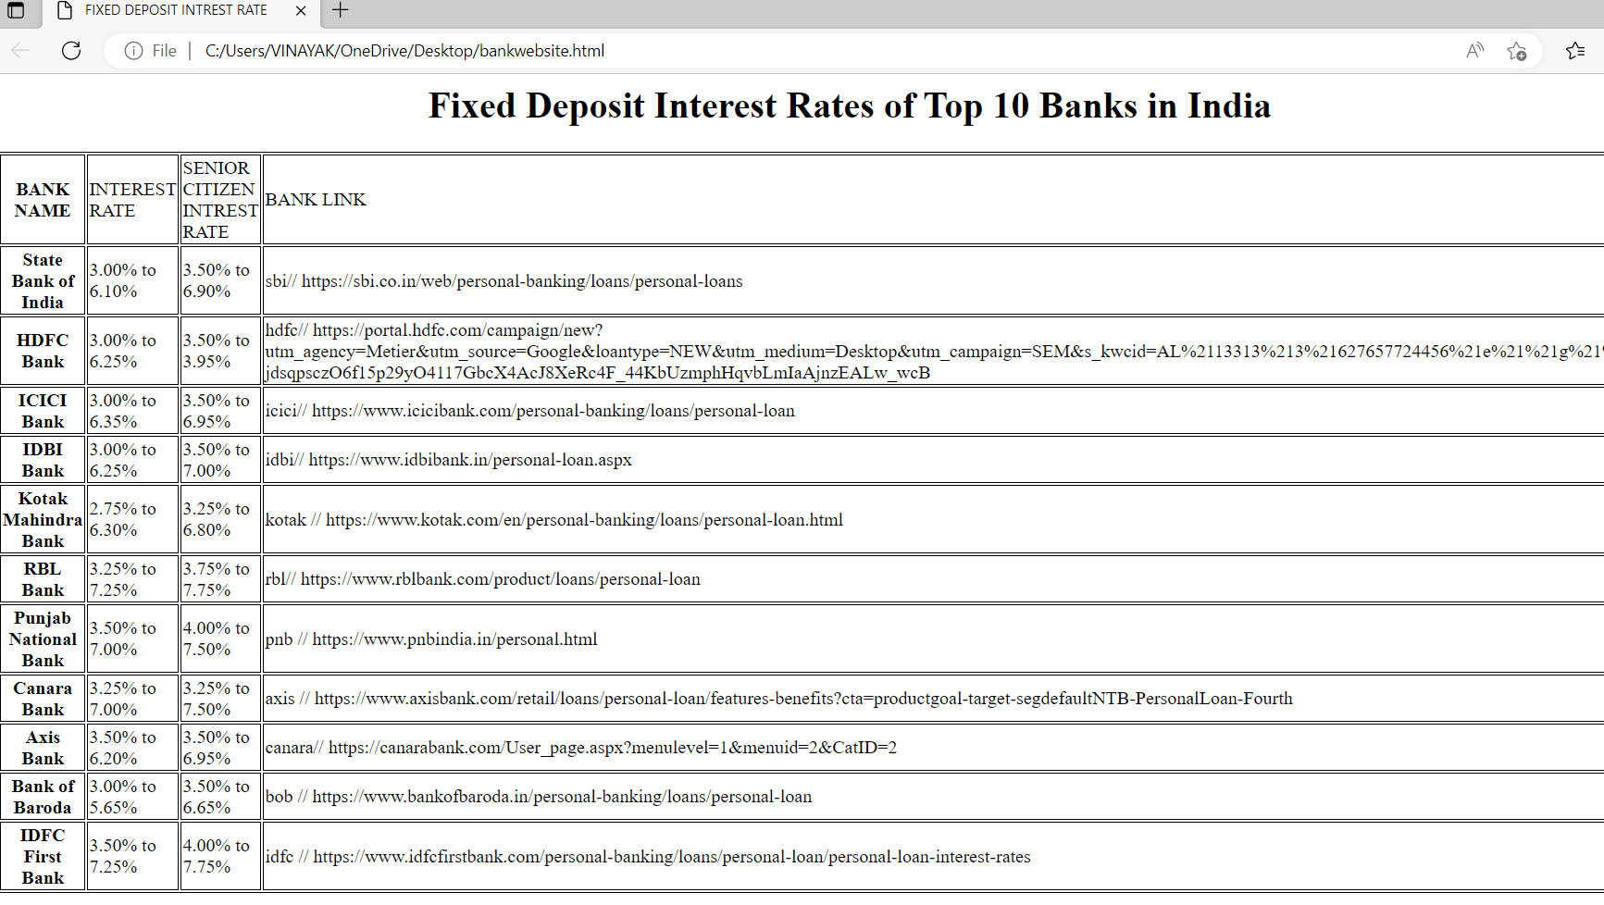
Functionality of the Project
Django

Slide 6
Future scope:
Digitalization is changing how people interact and do business on a day-to-day basis, and advancements in banking technology are continuing to influence the future of financial services around the world. An increasing demand for a digital banking experience from millennials and Gen Zers is transforming how the entire banking industry operates.
We are aspiring of introducing much more services apart from database or analysis ,like mutual funds ,net banking, and digital payments.

Slide 7
Thank You
(TEAMVIRUS)

